Slide 1


Mobile Apps Field Support
KICKOFF MEETING

Slide 2
Content
Team Introductions
Project Background
Project Goal
Project Objective
Business Process
Project Scope (In and Out)
Project Flow
Project Timeline
Milestones
Point of Contact
Project Control
Next Immediate Action
Q&A

Slide 3
Team Introductions
Morgan Peter
Rizky Fitriandini
Sjrafudin Lamusu
Yongkie Saputra

Slide 4
Team Introductions (Roles)
Morgan Peter (Designer)
Rizky Fitriandini (Business Analyst / Quality Control)
Sjrafudin Lamusu (System Designer / Software Developer)
Yongkie Saputra (Project Manager)

Slide 5
Project Background
FS team are not utilized properly and efficiently.
FS team availability are not reflected accurately.

Slide 6
Project Goal
Increase the FS team utilization.
Accurately monitors FS team availability.

Slide 7
Project Objective
Add new channel for FS team (Mobile).
Create dashboard to monitor FS team availability and Customer Feedback.

Slide 8
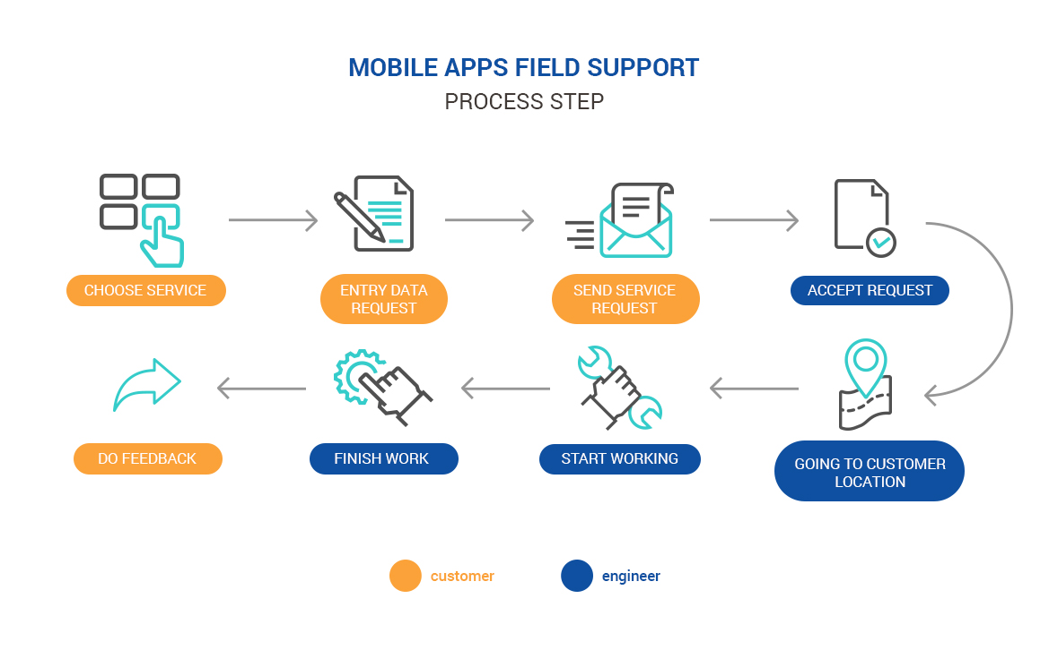
Business Process

Slide 9
Project Scope
Web API for mobile apps:
Authentication/Authorization:
Login.
Logout.
Master Data:
Services.
Categories.
Locations.
Banners.
Assignment:
Task Assignment.
Escalation.
Transfer/Delegation.

Slide 10
Project Scope
Inbox:
Listing.
Display Request.
Ticket Submission.
Dashboard:
Customer feedback (Bad/Poor).
Take Over / Transfer Assignment.
List FS Team (Geo Tagging).
Inbox Related Action (Notification).

Slide 11
Out of Scope
Export Data to Word, XML, Picture, Graph.
Users/Roles Communication.
Data Processing.

Slide 12
Project Flow
UI Design (Wireframing, Prototyping)
Requirements Gathering (Functional Approval Sheet, Functional Specification)
System Design (Design Document)
System Development (Application)
Quality Control (Test Script)
Deployment (Source Code, API, Framework, Library, User Manual)

Slide 13
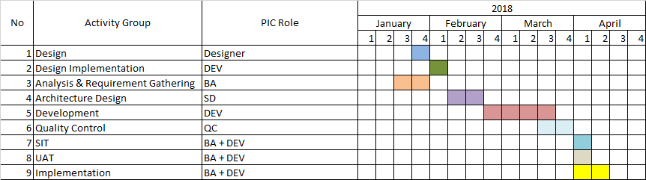
Project Timeline

Slide 14
Project Milestones
User Interface
Development and Testing
Source Code Handover to AI
3 Months Support Period

Slide 15
Project Milestones (Deliverables)
User Interface (UI Design)
Development and Testing (Functional Specification, Database Design, Application, Test Script)
Handover to AI (Source Code, API, Framework, Library, User Manual)
3 Months Support Period

Slide 16
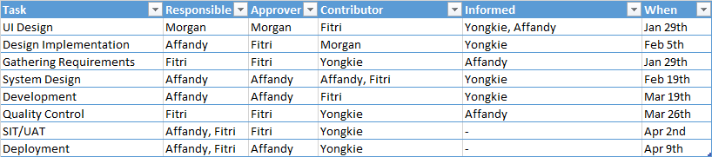
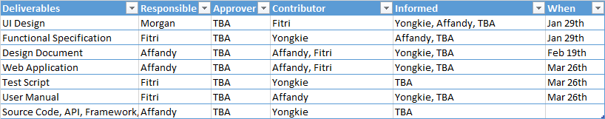
Project Milestones (Deliverables)

Slide 17
Project Point of Contact
Moonlay Technologies
Yongkie Saputra
Email : yongkie.saputra@moonlay.com
Phone : +6285959266027
Astra International
TBA
Email : TBA
Phone : TBA

Slide 18
Project Progress Control
GitHub
Weekly Meeting
Progress Report

Slide 19
Next Immediate Action
UI Design
Requirements Gathering
Update AI PIC

Slide 20
Q & A

Slide 21
Thank You

